Slide 1


Economic Development Administration
University Center
At the University of Wisconsin-Madison
An EDA Center Since 2016
Researchers
Tessa Conroy, Ph.D.
Steven Deller, Ph.D.
Matt Kures, M.S.
Kristin Runge, Ph.D.
Graduate Research Assistants
Rachel Ramthun
Jackson Parr
Principal Investigator
Kristin Runge, Ph.D.
Location
The Pyle Center
702 Langdon Street
Madison WI 53703
Activities
Applied Research
Education & Outreach
Assistance for Community Economic Development
Clients & Partners
Extension Educators
Economic Development Organizations & Stakeholders
Regional Planning Commissions
Municipalities & Counties
Tribal Governments
Website
https://cced.ces.uwex.edu/eda-university-center/
2019/2020
About the Center
The Economic Development Administration (EDA) University Center at the University of Wisconsin-Madison is supported by an EDA grant matched by the Division of Extension, which plays a critical role in disseminating its work across the State of Wisconsin.
Research Activities
The Center publishes a frequent, short-form series called WIndicators that looks at data surrounding a range of issues from business expansion to the role of foreign exports in the state’s economy to childcare as an economic development strategy and the role of immigration in entrepreneurship.
The Wisconsin Economy Series is a joint effort of the EDA University Center and the Department of Agricultural and Applied Economics. This series is an in-depth look at critical issues in Wisconsin, including manufacturing, sources of job growth, and effects of research and development investment in the state.
Our Economic Reports address episodic issues in the economy and detail methods for community-based economic development research. For example, Slow Churn: Declining Dynamism in America’s Dairyland discusses the birth and death rates for Wisconsin business startups and the implication for the state economy. A Trade Area Analysis of Wisconsin Retail and Service Markets provides instruction on how to use publicly available data to assess the local retail market.
Outreach Activities
The Center holds four major meetings annually that bring together stakeholders in each region to examine research on issues they have identified as critical to economic development. Meetings are held as in-services, summits or forums, depending on the preference of the economic development partners. Attendance ranges between 60 and 150 individuals, drawn from local, state and national elected leaders, economic development professionals, government agencies, and business leaders.
Assistance for Community Economic Development
Center researchers are frequently called on to directly assist communities or economic development partners. For example, Kristin Runge recently assisted the Village of Waunakee in conducting a year-long assessment and community engagement on the issue of affordable housing.
Tessa Conroy is involved in a project supporting entrepreneurs of color in the Fox Valley region of the state through research, developing a co-working space, and identifying grant opportunities.
Matt Kures has been working with several partners to identify and understand the implications of commuting and stretch commuting patterns in their regions.
Steve Deller has been leading a working group to identify community-based approaches to addressing the
lack of affordable housing across
the State of Wisconsin.

Slide 2
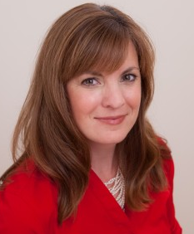

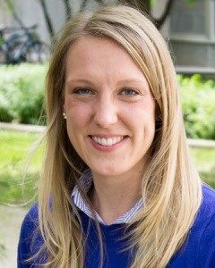

Economic Development Administration
University Center
At the University of Wisconsin-Madison
Serving the State of Wisconsin and its communities through research, education, and assistance related to community economic development
Kristin Runge, Ph.D.
Kristin specializes in strategic communication research, social media marketing, and public opinion at the intersection of the economy and the environment.
kristin.runge@wisc.edu
Steve Deller, Ph.D.
Steve focuses on understanding the rural economic with an eye towards policies that can effect changes in the local and regional economies.
SCDeller@wisc.edu
Tessa Conroy, Ph.D.
Tessa specializes in economic growth through entrepreneurship. Her research identifies the drivers of entrepreneurial regions, particularly the factors relevant to under-represented groups.
tessa.conroy@wisc.edu
Matt Kures, M.S.
Matt focuses on regional economic analysis, labor force research, and industry sector competitiveness, including labor mobility, and regional commuting patterns.
matthew.kures@wisc.edu
Located at The Pyle Center
702 Langdon Street ● Madison WI 53703 ● (608) 265-8136
https://cced.ces.uwex.edu/eda-university-center/

